Slide 1

MARVEL-ous Data Mining : The Next MARVEL Star

Slide 2



Team Members
Aditi
Ogidan
Paul
Pauline

Slide 3
Hypothesis Multi-character marvel franchises are more successful than single character films, regardless of demographic

Slide 4
Questions Asked What are the top Marvel Movie Franchises? What characters interact with each other in the Marvel Universe? what would comprise a successful movie release strategy?

Slide 5




Tools Used
Pandas
Marvel Api
Imbd / remove
Census Api
Gmaps
Pyvenn
Wordcloud
MCU api
Simple maps.com
Mpaa.org

Slide 6
Top Grossing Movies

Slide 7
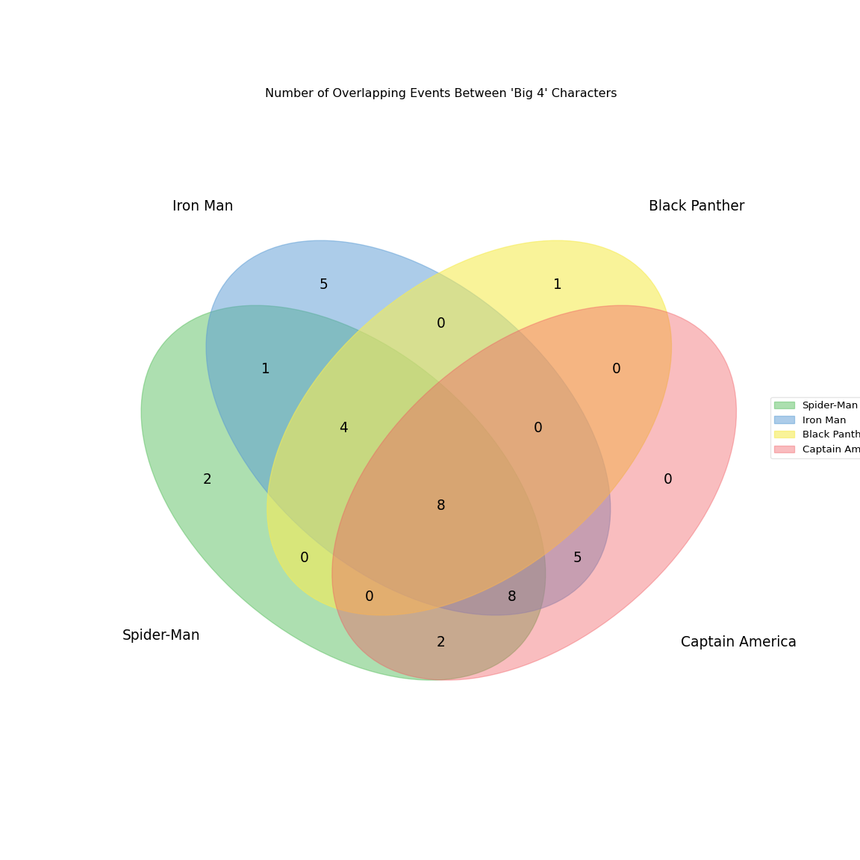
Number of Overlapping Events Between "Big 4" Characters
Number of Overlapping Events Between "Big 4" Characters
Number of Overlapping Events Between "Big 4" Characters

Slide 8


Conclusion

Slide 9
Data Clean up & exploration -census data cleanup -data merge

Slide 10
Data Analysis & Findings -industry research -descriptive stats -data distribution - zscore calculation for heat map weight

Slide 11
Conclusion Bigger metro areas eg NY, Chicago, higher population den…….

